Slide 1
Audio Scrambler
By Andrew Nguyen

Slide 2
Project Description
This project implements an audio scrambler that scrambles segmented sections of audio.
The scrambling method follows a standard Gaussian Distribution (Normal Distribution)
Allows preservation of easily identifiable audio after scramble
The audio files will be of the same length scrambled & unscrambled.

Slide 3
Implementation
Audio is first segmented into frames, and these frames are than segmented even further into individual windows
Convert these frames into a matrix that can be easily resorted based on an index
Create a random index using the Gaussian distribution.
Set the new positions for each of the audio windows
Sort the frames using the generated random index
Recompile each of the frames in order to created the scrambled audio.

Slide 4
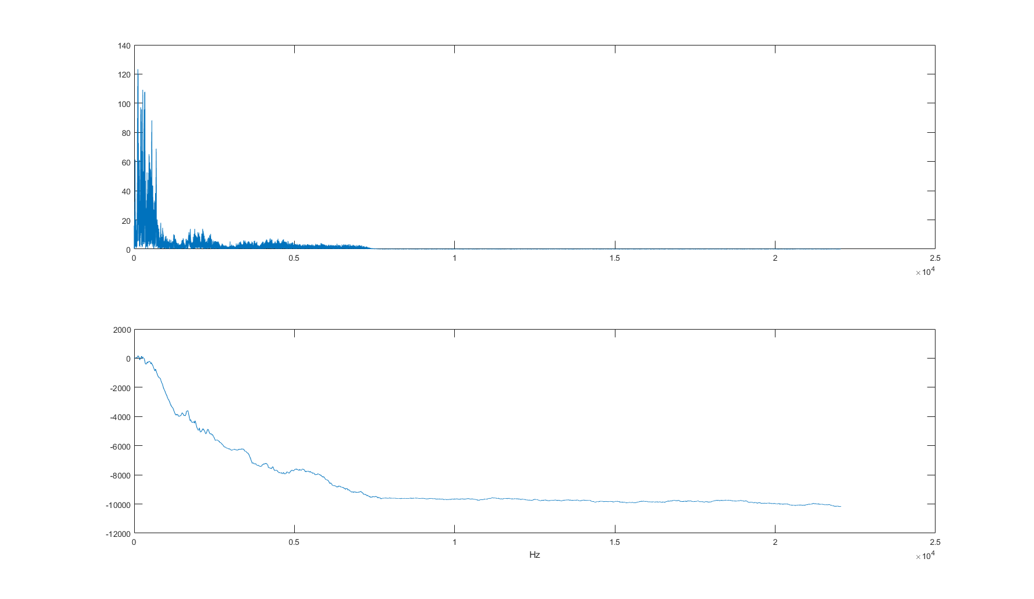
Magnitude & Phase of Unscrambled Audio

Slide 5
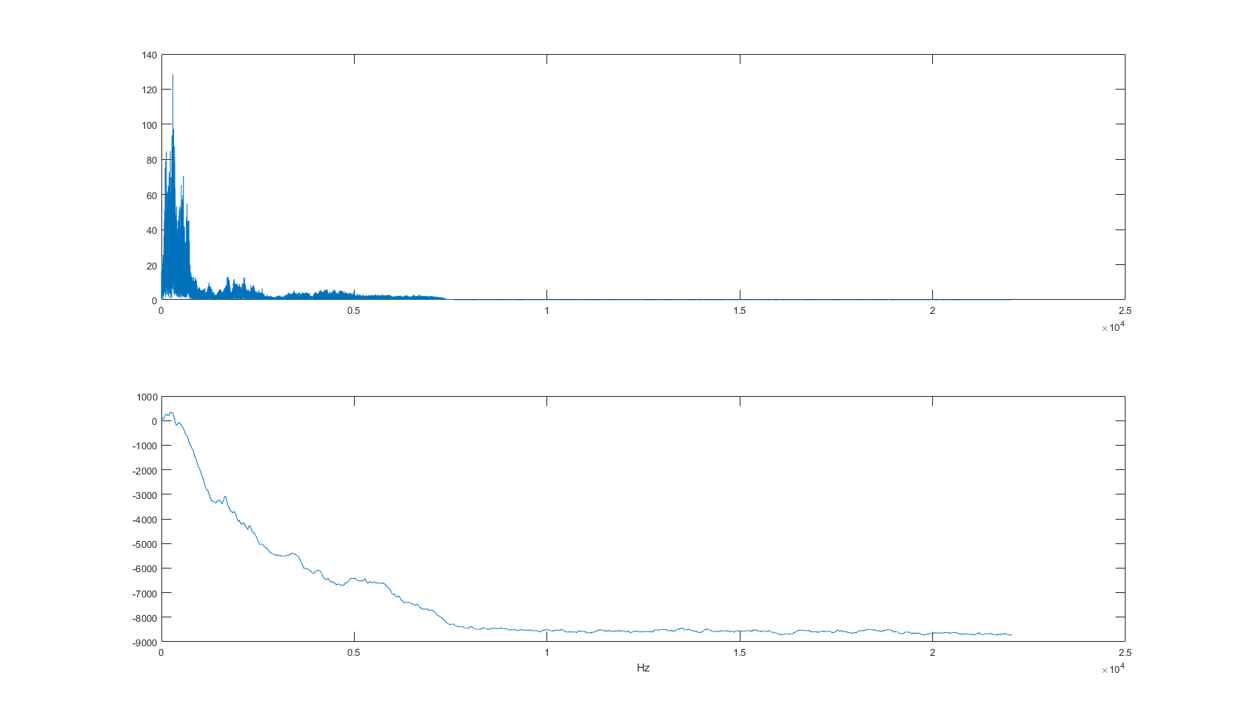
Magnitude & Phase of Scrambled Audio

